Slide 1

under supervision of
Mr. Umashankar Sharma
Anonymity and Confidentiality in Website using ML
Aditya Mishra (2101321530003)
Anshuman Soni (2101321530007)
Anuj Mishra
(2101321530008)
Shivam Singh (2101321530045)

Slide 2
Project title Justification
Phishing is a growing cybersecurity threat where attackers impersonate legitimate websites to steal sensitive information like passwords, credit card numbers, or personal identification data. Traditional methods of detecting phishing websites rely heavily on blacklists or rule-based systems, which often fail to detect new phishing websites in real-time. Machine learning (ML) provides an effective solution as it can detect patterns and characteristics of phishing websites dynamically. By leveraging machine learning, the system can learn from large datasets, identify phishing sites more accurately, and evolve as attackers modify their tactics. This project aims to improve the detection rate and reduce false positives, contributing to a safer online environment.

Slide 3
Objective of the Project
Develop a system to detect Anonymity and secure Confendentiality in website using Phising Website Detection System: Build an ML model capable of identifying phishing websites based on website features (e.g., URL structure, website content, domain age).
Evaluate Different Machine Learning Algorithms: Compare the performance of different algorithms (such as Decision Trees, Random Forest, Support Vector Machines, and Neural Networks) to find the most efficient model.
Feature Selection and Engineering: Identify key features of phishing websites to improve the model's performance.
Implementation of a Real-Time System: Integrate the ML model into a system that can perform real-time phishing detection on websites.
Evaluate Accuracy and Efficiency: Measure the system’s accuracy, sensitivity, and false-positive rate to
ensure high performance.

Slide 4
Data Collection
Data Collection:
Phishing Website Data: Gather datasets from publicly available sources such as PhishTank, UCI repository, or Kaggle, which contain records of both phishing and legitimate websites.
Legitimate Website Data: Collect data from trustworthy sources for a balanced comparison with phishing websites.
Data sets:
The set of phishing URLs are collected from opensource service called PhishTank. This service
provide a set of phishing URLs in multiple formats like csv, json etc. that gets updated hourly. To
download the data: https://www.phishtank.com/developer_info.php. From this dataset, 5000 random phishing URLs are collected to train the ML models.
The legitimate URLs are obatined from the open datasets of the University of New
Brunswick, https://www.unb.ca/cic/datasets/url-2016.html. This dataset has a collection of benign,
spam, phishing, malware & defacement URLs. Out of all these types, the benign url dataset is considered for this project. From this dataset, 5000 random legitimate URLs are collected to train the ML models.

Slide 5
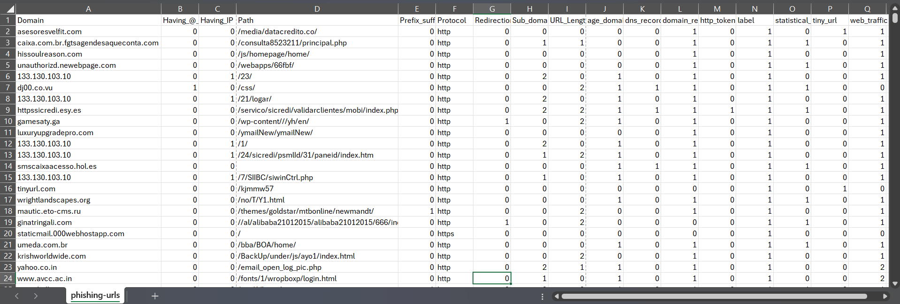
Phishing_sites.csv

Slide 6
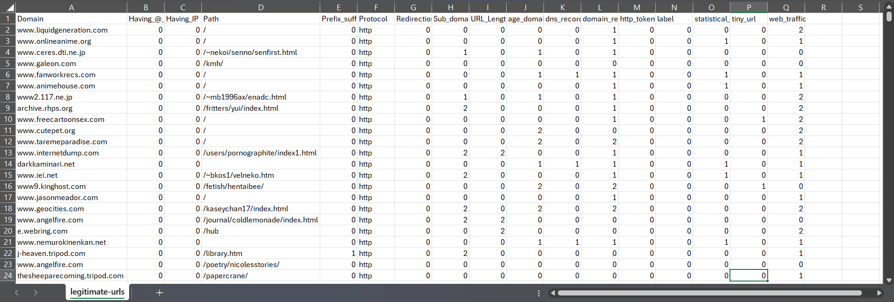
Legitimate_sites.csv

Slide 7
Feature Extraction
Feature Extraction consists of:
Extract significant features from website URLs and webpage content that differentiate phishing websites from legitimate ones.
Key features to consider:
URL-based features: Length of URL, presence of special characters, use of IP address instead of a domain name, presence of suspicious keywords.
Domain-based features: Domain age, domain name length, registration information, presence of SSL certificates.
Page-based features: Website content, use of HTTPS, form handling, third-party resources.
The below mentioned category of features are extracted from the URL data:
Address Bar based Features
In this category 9 features are extracted.
Domain based Features
In this category 4 features are extracted.
HTML & Javascript based Features
In this category 4 features are extracted.
So, all together 17 features are extracted from the 10,000 URL dataset.

Slide 8
Feature Extraction
1. Address Bar based Features considered are:
Domian of URL
Redirection '//' in URL
IP Address in URL
'http/https' in Domain name
'@' Symbol in URL
Using URL Shortening Service
Length of URL
Prefix or Suffix "-" in Domain
Depth of URL
2. Domain based Features considered are:
DNS Record
Website Traffic
Age of DomainEnd
Period of Domain
3. HTML and JavaScript based Features considered are:
Iframe Redirection
Status Bar Customization
Disabling Right Click
Website Forwarding

Slide 9
Feature Extraction for Phishing Website Detection
1. Using URL Shortening Services
Objective: Identify phishing attempts using shortened URLs.
Method: Detect URL shortening services like "bit.ly" or "tinyurl.com" through keyword matching. These services obscure the true destination, often used by attackers.
2. Existence of HTTPS Token
Objective: Avoid misleading security indicators in the domain.
Method: Flag URLs containing “HTTPS” in places other than the protocol (e.g., "httpssecure.com").
3. Abnormal URL
Objective: Validate the legitimacy of domains.
Method: Cross-check domains against WHOIS databases to verify registration details. Abnormal or unregistered domains raise suspicion.
4. Google Index
Objective: Confirm the URL is indexed by search engines.
Method: Use Google search APIs to verify if the URL exists in Google's database. Non-indexed sites are more likely to be phishing.
5. Website Traffic
Objective: Assess website popularity.
Method: Analyze Alexa rank data. Legitimate sites usually have higher traffic, while phishing sites rank low or are absent.

Slide 10
6. Domain Registration Length
Objective: Detect short-lived domains.
Method: Phishing domains often register for under a year. WHOIS checks identify short registration durations.
7. Age of Domain
Objective: Identify newly created domains.
Method: WHOIS records reveal the domain's age. New domains are a common indicator of phishing attempts.
8. DNS Record
Objective: Verify domain validity.
Method: DNS queries ensure the existence of legitimate records. Missing or invalid records suggest phishing activity.
9. Statistical Report
Objective: Leverage threat intelligence databases.
Method: Match URLs and IPs against lists of known phishing entities. Regularly updated datasets enhance accuracy.
10. Long URLs
Objective: Detect unusually long URLs.
Method: URLs exceeding a standard character limit (e.g., >75 characters) are flagged as suspicious.
11. @ Symbol in URL
Objective: Identify domain obfuscation techniques.
Method: The "@" symbol redirects users to different pages and is typically used in phishing URLs.

Slide 11
12. Double Slashes (//) in Path
Objective: Detect abnormal URL formatting.
Method: URLs with "//" in unexpected places (other than "http://") are flagged as suspicious.
13. Subdomains
Objective: Identify excessive subdomains.
Method: Count the number of dots in the URL. Phishing URLs often use multiple subdomains to confuse users (e.g., "login.bank.com.fake.com").
14. IP Address Usage
Objective: Detect direct IP addresses in URLs.
Method: URLs using raw IPs instead of domain names are flagged, as legitimate sites typically avoid this practice.

Slide 12
Implementation
The script is designated to detect phishing websites by extracting specific features from URLs. The key steps involved:
Feature Extraction Class:
The class FeatureExtraction defines methods for various URL characteristics, such as:
Protocol (e.g., HTTP, HTTPS)
Domain: Checks if the domain is an IP address or a typical domain name.
URL Length: Longer URLs are often used in phishing sites.
Subdomains: More than three subdomains might indicate a phishing attempt.
Redirection and Symbols: Phishing sites often use tricks like @ symbols or redirect symbols (//).
Tiny URLs: Shortened URLs often lead to phishing sites.
WHOIS Lookup: The script uses the whois library to fetch domain registration details such as the domain’s age and expiration date, which help assess if a website is legitimate. Short-lived or recently created domains are red flags.
Web Traffic Analysis: It checks the popularity of a site based on its Alexa ranking, as legitimate sites tend to have higher traffic.
CSV File Generation: After processing each URL from a file, the script stores the extracted features in a DataFrame and saves the data into a CSV file labeled as "phishing-urls.csv."
Labeling: The URLs are labeled based on the extracted features, helping in the classification of the website as legitimate, phishing, or suspicious.
This approach can be used to train machine learning models to automate phishing detection.

Slide 13
1. Data Collection:
Collect URL data from different sources, including legitimate and phishing websites. Files like legitimate_urls.txt and 1000-phishing.txt provide the URLs used for training.
2. Feature Extraction (Class FeatureExtraction):
Protocol: Extract whether the URL uses "http" or "https".
Domain: Extract the domain name of the URL.
Path: Extract the path from the URL.
Having IP: Check if the domain contains an IP address.
URL Length: Measure the length of the URL to classify it as suspicious or legitimate.
@ Symbol: Check for the presence of "@" in the URL.
Redirection: Detect if the URL contains a "//" after the protocol.
Subdomains: Count the number of subdomains in the URL.
Shortening Services: Detect URLs shortened using services like bit.ly, goo.gl.
Web Traffic: Use Alexa rank to check the popularity of the domain.
Domain Registration Length: Extract domain registration and compare the validity.
Age of Domain: Calculate the age of the domain based on registration date.
DNS Records: Check DNS information for additional classification.
Statistical Report: Conduct a statistical analysis on the URL to detect anomalies.
HTTPS Token: Check if the URL starts with "https://" for security validation.
3. Data Labeling:
URLs are labeled as:
0: Legitimate
1: Phishing
2: Suspicious
4. Model Training:
Use RandomForestClassifier or DecisionTreeClassifier for the model to classify URLs as phishing or legitimate based on extracted features.
5. Web Interface:
The app.py file likely serves the model using a web framework (e.g., Flask) and includes UI files like home.html, _navbar.html, and about.html for user interaction.
6. Model Saving and Loading:
After training, save the model to a file like RandomForestModel.sav for future use.
7. Prediction:
For new URLs, the system extracts features, processes them, and uses the trained model to classify the URL as phishing or legitimate.

Slide 14
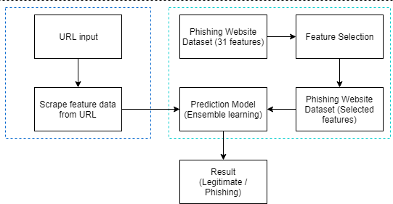
METHODOLOGY
Technologies Used:
Detecting phishing websites using machine learning algorithms typically
involves using supervised learning techniques. Some common machine
learning algorithms and methods used for phishing website detection include:
1. Decision Trees: Decision trees can be effective for phishing detection
as they can capture complex relationships between features. Ensemble
methods like Random Forests and Gradient Boosting Machines (GBM) can also be used for improved performance.
2. Random Forest: Random Forests are a powerful ensemble learning algorithm that combines multiple decision trees to improve accuracy and robustness. They are particularly effective for handling high-dimensional data and are widely used in various applications, including classification and regression tasks.
Fig. Flowchart of the Phishing Website Detection: An Improved Accuracy through Feature Selection and Ensemble Learning

Slide 15
METHODOLOGY
Before stating the ML model training, the data is split into 70-30 i.e., 7000 training samples & 3000 testing samples. From the dataset, it is clear that this is a supervised machine learning task. There are two major types of supervised machine learning problems, called classification and regression.
This data set comes under classification problem, as the input URL is classified as phishing (1) or
legitimate (0). The supervised machine learning models (classification) considered to train the dataset in this project are:
Decision Tree
Random Forest
Multilayer Perceptrons
XGBoost
Autoencoder Neural Network
Support Vector Machines
All these models are trained on the dataset and evaluation of the model is done with the test dataset.

Slide 16
How does phishtank create dataset for train phishing website models?
1. Feature Extraction
Machine learning models use different types of features to distinguish between phishing and legitimate websites. These features fall into three categories:
A. URL-Based Features (Static Analysis)
Extracted from the URL string itself:
Length of URL (Shorter URLs are often legitimate, extremely long URLs may be phishing)
Use of IP Address Instead of Domain (http://192.168.1.1/login.php → Likely phishing)
Presence of "@" Symbol (Redirects user, common in phishing)
Number of Dots (.) in URL (Excessive subdomains like login.bank-secure.com.phish.com)
URL Shortening Service Used (bit.ly, tinyurl, etc. → Often used in phishing)
B. Domain-Based Features (DNS & WHOIS Data)
Extracted from domain records:
Domain Age (Newly registered domains are suspicious)
Domain Expiry (Short expiration time is a phishing indicator)
Alexa Rank (Legitimate websites usually have higher ranks)
HTTPS Presence (Phishing sites often lack SSL certificates)
C. HTML & JavaScript-Based Features (Page Content Analysis)
Extracted from the website’s source code:
Using IFrames (Hides the real URL to deceive users)
Right-Click Disabled (Prevents users from checking site security details)
Form Submits to Different Domain (Login page sends credentials to an unknown website)

Slide 17
1 → Phishing Indicator (Feature is present in phishing sites)
-1 → Safe Indicator (Feature suggests a legitimate site)
0 → Neutral (No strong influence on classification)
2. Labeling System (-1, 0, 1)
Each extracted feature is assigned a numerical label based on its classification:
Feature | Value | Meaning
Presence of "@" in URL | 1 | Likely phishing
URL Length (>75 characters) | 1 | Suspicious (possible phishing)
HTTPS Certificate Present | -1 | Safe (legitimate site)
Domain Age > 1 year | -1 | Safe (old, established domain)
Domain Age < 1 month | 1 | High risk (new domain, likely phishing)
Shortened URL (bit.ly, etc.) | 1 | Phishing indicator
No JavaScript Redirection | -1 | Safe (legitimate site)
IFrame Detected | 1 | Phishing attempt detected
Alexa Rank in Top 1000 | -1 | Safe (popular, trusted site)
Alexa Rank Not Found | 1 | Suspicious (new or unknown site)

Slide 18
3. How These Values Get Filled in the Dataset:
Automated Scripts & Web Crawlers scan and extract features from URLs.
WHOIS & DNS Queries fetch domain age, SSL info, and registration details.
Machine Learning Models analyze website behavior, classify features, and assign -1, 0, or 1 based on previous phishing patterns.
4. How Machine Learning Uses These Values:
A dataset with labeled values (-1, 0, 1) is fed into an ML model.
The model learns which features strongly indicate phishing.
When a new website is tested, the model predicts whether it’s phishing or legitimate based on feature values.

Slide 19
Testing
In the Phishing Website Detection project, testing the model involves the following steps:
Data Splitting: The dataset is divided into training and testing sets, typically using an 80-20 or 70-30 ratio. This ensures that the model is evaluated on unseen data.
Model Evaluation: After training the classifier (e.g., RandomForest or DecisionTree), the model is tested using the testing dataset. Performance is evaluated using metrics such as:
Accuracy
Precision
Recall
F1-Score
Cross-validation: To ensure robustness, cross-validation techniques like k-fold cross-validation may be applied to assess the model's performance across multiple subsets of the data.
Confusion Matrix: A confusion matrix helps visualize the classification results, showing true positives, false positives, true negatives, and false negatives.
Performance Visualization: The performance metrics, such as accuracy and F1-score, are plotted to assess how well the model is generalizing.
Model Tuning: Hyperparameters of the classifier can be adjusted (e.g., number of trees in Random Forest) to improve the model’s performance on the test set.

Slide 20
CURRENT PROTOTYPE FUNCTIONALITY
The current prototype of the phishing website detection system is designed to identify phishing attempts using machine learning algorithms. It performs the following key functions:
Feature Extraction from URLs
Analyzes critical features such as URL length, presence of special characters, domain age, HTTPS usage, and subdomain patterns.
Extracts domain-based features like DNS records, web traffic, and registration details to determine legitimacy.
Machine Learning-Based Classification
Utilizes Decision Tree, Random Forest, and Support Vector Machine (SVM) to classify websites as either phishing or legitimate.
Compares the accuracy, false positive, and false negative rates of different models to determine the most effective algorithm.
Dataset Training and Evaluation
Uses phishing and legitimate URL datasets from PhishTank and the University of New Brunswick for model training.
Evaluates model performance using accuracy, precision, recall, and F1-score to measure reliability.
User Input and Prediction
Allows users to enter a website URL for real-time classification.
Displays the classification result (Legitimate or Phishing) with confidence scores.
Static Model Performance
The model is trained on a fixed dataset and does not currently update itself dynamically with new phishing threats.
Limitations of the Current Prototype
Lack of Real-Time Updates: The model does not continuously learn from new phishing threats.
No Browser Integration: The system is not yet implemented as a browser extension or API.
Focus on URL-Based Features: It does not analyze webpage content or behavioral patterns for phishing detection.

Slide 21
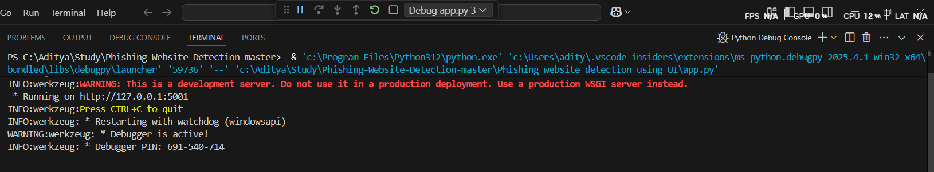
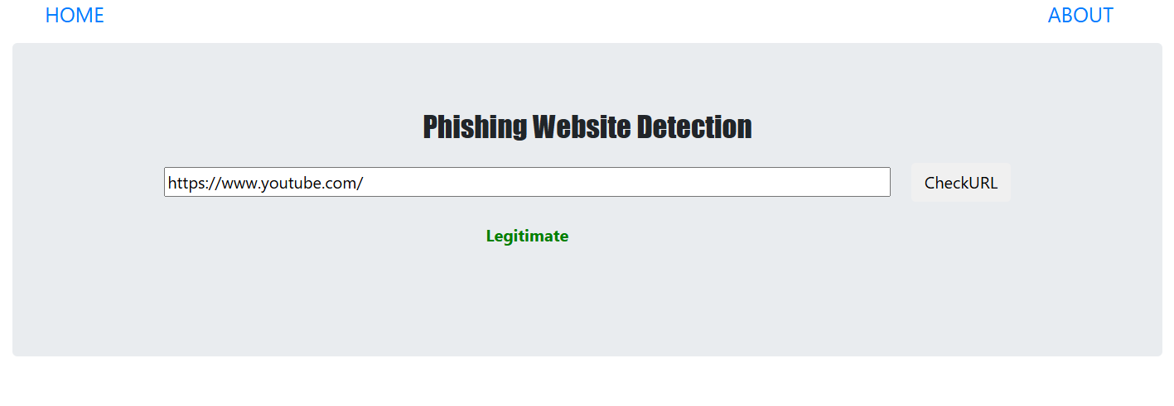
OUTPUT
Fig.I. Output and link to open local webapp using Flask
FrontEnd View:-
Legitimate Website Examles:-
Fig.II. Youtube URL as legitimate website

Slide 22
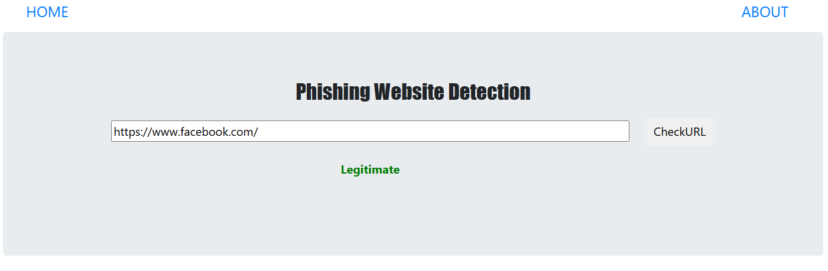
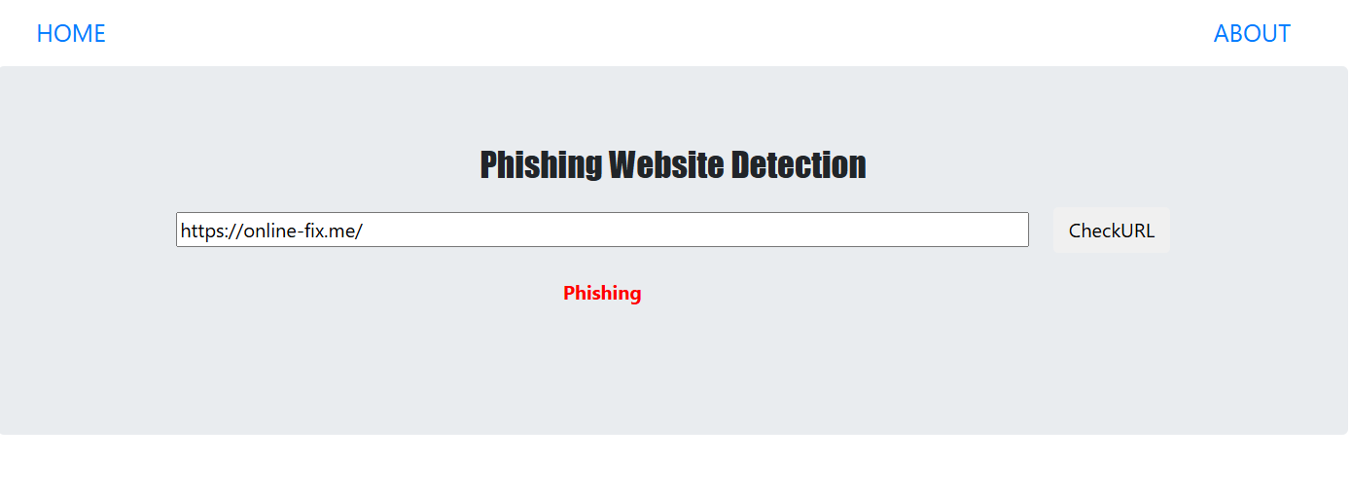
Fig.III. Facebook URL as legitimate website
Phishing Websites Examples :-
Fig.IV. OnlineFix(3rd party gaming website) URL as Phishing website

Slide 23
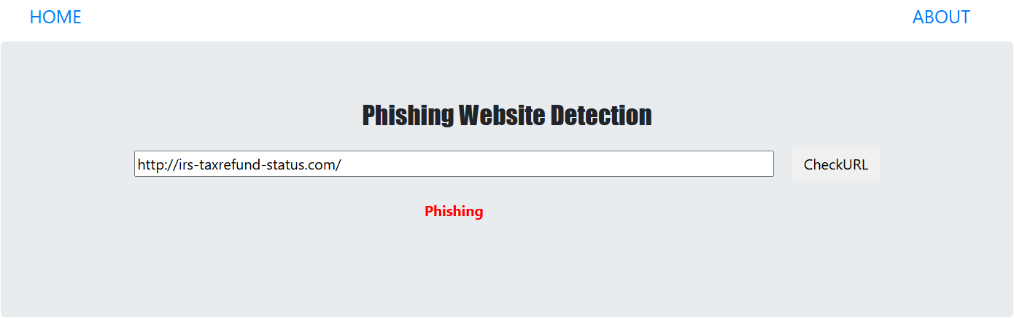
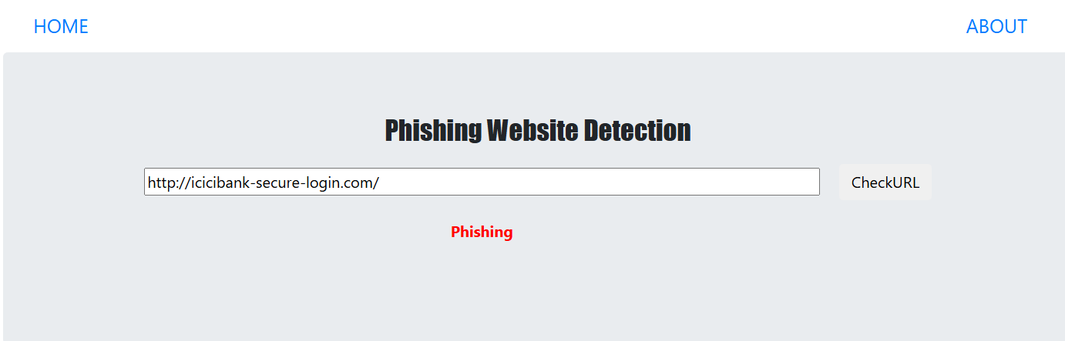
Fig.V. Irs taxrefund fake website URL as Phishing website
Fig.VI. Icici bank fake website URL as Phishing website

Slide 24
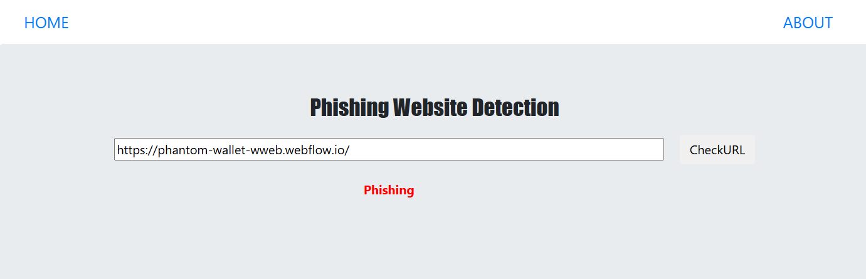
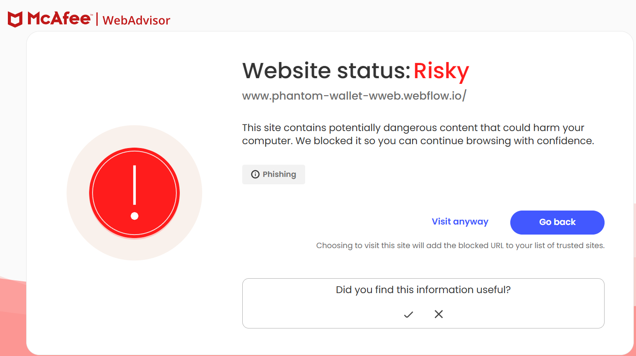
Fig.VI. Icici bank fake website URL as Phishing website
Fig.VII. McAfee web advisor’s warning

Slide 25
FUTURE WORK
The phishing detection system developed in this project has shown promising results in identifying malicious websites using machine learning techniques. However, there is still significant scope for improvement and expansion. Future work will focus on the following areas:
Real-time Detection and Automation
Enhancing the system to perform real-time phishing detection with minimal latency.
Automating dataset updates to continuously train the model on the latest phishing techniques and emerging threats.
Browser Extension and API Development
Developing a browser extension that can provide instant alerts to users when visiting a suspicious website.
Creating an API that allows third-party applications and security platforms to integrate phishing detection capabilities.
Hybrid Approach for Better Accuracy
Combining machine learning with rule-based techniques (such as blacklists and heuristics) to reduce false positives and improve reliability.
Implementing ensemble learning methods that combine multiple models for higher detection accuracy.
Cross-Platform Compatibility
Expanding the system to work across different devices and platforms, including mobile applications.
Optimizing resource usage for better performance on low-power devices.
Adversarial Attack Defense Mechanisms
Strengthening the model against adversarial attacks where attackers modify URLs or page content to bypass detection.
Implementing robust feature selection methods to counter phishing techniques that evolve over time.
By implementing these future improvements, the phishing detection system can become more effective, adaptive, and user-friendly, ultimately enhancing cybersecurity for individuals and organizations.

Slide 26
Project Time Plan (Dec 2024 – May 2025)
Phase | Tasks | Duration | Milestones
1. Planning & Research | - Define project objectives - Research phishing techniques & detection methods - Study existing ML models & datasets | Dec 2024 (4 weeks) | Project proposal finalized
2. Data Collection & Preprocessing | - Gather phishing & legitimate website datasets - Clean, preprocess, and structure data - Feature selection & engineering | Jan 2025 (4 weeks) | Dataset ready for training
3. Model Selection & Training | - Choose ML algorithms (e.g., Decision Tree, Random Forest, SVM) - Train models on the dataset - Optimize hyperparameters | Feb 2025 (4 weeks) | Initial model trained
4. Model Evaluation & Improvement | - Test models on validation data - Improve accuracy & reduce false positives - Compare models & select the best | Mar 2025 (4 weeks) | Final model selected
5. Web Application Development | - Develop front-end - Implement backend (Flask) - Integrate ML model into web app | Apr 2025 (4 weeks) | Web app prototype ready
6. Testing & Deployment | - Perform security & functionality testing - Finalize documentation & presentation | May 2025 (4 weeks) | Project completed & deployed

Slide 27
Conclusion related to Project
The project focuses on detecting phishing websites using a Random Forest Classifier. It employs 14 feature extraction methods, such as URL length, traffic ranking, and subdomain analysis. After merging the legitimate and phishing URL datasets, the data is shuffled to avoid overfitting and split into training (70%) and testing (30%) datasets. Feature importance analysis shows that URL length and web traffic are the most significant predictors. A bar plot is used to illustrate the ranked feature importances, providing a clearer understanding of their influence on phishing detection.

Slide 28
ABSTRACT
A phishing attack is the simplest way to obtain sensitive information from innocent users. The aim of the phishers is to acquire critical information like username, password, and bank account details. Cybersecurity people are now looking for trustworthy and steady detection techniques for phishing website detection.
This project deals with machine learning technology for the detection of phishing URLs by extracting and analyzing various features of legitimate and phishing URLs.
Decision Tree, Random Forest, and Support Vector Machine algorithms are used to detect phishing websites. The aim of the paper is to detect phishing URLs as well as narrow down to the best machine learning algorithm by comparing accuracy rate, false positive rate, and false negative rate of each algorithm.

Slide 29
LITERATURE SURVEY
[1] Marwa Abd Al Hussein Qasim, Dr. Nahla Abbas Flayh : Using six criteria based on URL parameters such as the subdomain, principal domain, Page rank, Alexa rank, path domain, and Alexa reputation, this article suggests a novel method for identifying phishing websites. The method focuses on evaluating how closely a phishing site's URL resembles the URL of a reliable website and also takes into account the site's ranking as a crucial component in determining its validity. The approach was tested using data from PhishTank and DMOZ, and the authors showed that it could identify over 97% of phishing sites.
Key findings :-
Subdomain and Principal Domain: Analyzing these components helps in identifying suspicious patterns that are common in phishing attempts.
PageRank: The study found that about 95% of phishing sites have no PageRank, suggesting that low or absent PageRank values can be indicative of phishing
activity.
Alexa Rank: Websites with an Alexa rank greater than 100,000 were classified as suspicious or phishing, while those ranked lower were deemed legitimate.
Path Domain and Alexa Reputation: These elements further refine the classification process by evaluating the trustworthiness associated with the URL path
and overall site reputation.
Irfan Siddavatam, Rishikesh Mahajan : Introduced the use of decision trees , SVM, Random Forest to classify phishing websites based on features like URL length, domain age, presence of special characters, and security certificate information. Their approach demonstrated improved detection rates compared to traditional methods but faced challenges in identifying phishing sites.
Key findings :-
URL Length: Longer URLs often indicate phishing attempts.
Domain Age: Newly registered domains are frequently associated with phishing.
Special Characters: The presence of unusual characters can signal malicious intent.
Security Certificate Information: Lack of valid SSL certificates is a common trait of phishing sites.

Slide 30
LITERATURE SURVEY
[13] Ankit Kumar Jain & B. B. Gupta : The proposed strategy utilizes an Innovative methodology for defending counteract phishing attempts by incorporating a URL and DNS matching module with a white list of trusted websites that are automatically up-dated based on each user's browsing history. This method offers quick retrieval speeds, high rates of detection, and alerts users to not disclose personal information when at-tempting to access a website, not on the white list. Additionally, hyperlink properties are utilized to verify the validity of a website by retrieving hyperlinks from the source code and applying them to the phishing detection method. The performance of this strategy was evaluated using data from reputable sources such as Stuffgate, Alexa, and PhishTank and achieved an accuracy rate of
89.38 %.
Key findngs :-
Detection and Alert Mechanism:
The system offers quick retrieval speeds and high detection rates of phishing attempts. Users are alerted not to disclose personal information when attempting
to access websites that are not on the whitelist, providing an additional layer of protection.
Utilization of Hyperlink Properties:
The method leverages hyperlink properties by retrieving hyperlinks from the source code of websites. This information is then applied to the phishing detection
process, further validating the legitimacy of a site.
Performance Evaluation:
The performance of this strategy was rigorously evaluated using data from reputable sources such as Stuffgate, Alexa, and PhishTank. The approach achieved
an accuracy rate of 89.38%, indicating its effectiveness in identifying phishing sites.
[14] M. Aydin and N. Baykal : Throughout this experiment, phishing websites were detected using subset-based feature selection methods based on URL attributes. A da-taset comprising both legitimate and phishing URLs was obtained from Google and PhishTank, and multiple features were retrieved from URLs. The usefulness of two classification algorithms—Naive Bayes and Sequential Minimal Optimization (SMO)—for identifying phishing websites was investigated in this study. The results showed that SMO performed bette r than Naive Bayes for phishing detection, with an accuracy rate of 95.39%. The SMO algorithm also had another benefit in that it made use of more chosen features overall. The accuracy rate of the Naive Bayes method, in contrast, was 88.17% while using the same quantity of chosen features.
Key findings :-
Performance Results:
The results indicated that the SMO algorithm outperformed Naive Bayes, achieving an impressive accuracy rate of 95.39% in detecting phishing websites.
In contrast, the Naive Bayes method yielded an accuracy rate of 88.17%, despite utilizing the same number of selected features.
Feature Selection Benefits:
The SMO algorithm demonstrated a significant advantage by employing a larger number of selected features overall, which contributed to its superior
performance in distinguishing between phishing and legitimate websites.

Slide 31
REFERENCES
Marwa Abd Al Hussein Qasim, Dr. Nahla Abbas Flayh, “Phishing Website Detection Using Machine Learning: A Review” June 2023Wasit Journal of Pure sciences 2(2):270-2812(2):270-281
Rishikesh Mahajan, Irfan Siddavatam ,”Phishing Website Detection using Machine Learning Algorithms” ,
International Journal of Computer Applications, Volume 181 - Number 23 Year of Publication: 2018
S. A. Anwekar and V. Agrawal, "PHISHING WEBSITE DETECTION USING MACHINE LEARNING ALGORITHMS."
S. Jain, "Phishing Websites Detection Using Machine Learning," Available at SSRN 4121102.
A. Lakshmanarao, P. S. P. Rao, and M. B. Krishna, "Phishing website detection using novel machine learning fusion approach," in 2021 International Conference on Artificial Intelligence and Smart Systems (ICAIS), 2021: IEEE, pp. 1164- 1169.
L. Tang and Q. H. Mahmoud, "A Deep Learning-Based Framework for Phishing Web-site Detection," IEEE Access, vol. 10, pp. 1509-1521, 2021.
A. D. Kulkarni and L. L. Brown III, "Phishing websites detection using machine learn-ing," 2019.
I. Tyagi, J. Shad, S. Sharma, S. Gaur, and G. Kaur, "A novel machine learning ap-proach to detect phishing websites," in 2018 5th International conference on signal pro-cessing and integrated networks (SPIN), 2018: IEEE, pp. 425-430.

Slide 32
REFERENCES
M. Karabatak and T. Mustafa, "Performance comparison of classifiers on reduced phishing website dataset," in 2018 6th International Symposium on Digital Forensic and Security (ISDFS), 2018: IEEE, pp. 1-5.
X. Zhang, Y. Zeng, X.-B. Jin, Z.-W. Yan, and G.-G. Geng, "Boosting the phishing detection performance by semantic analysis," in 2017 IEEE international conference on big data (big data), 2017: IEEE, pp. 1063-1070.
W. Fadheel, M. Abusharkh, and I. Abdel-Qader, "On Feature selection for the prediction of phishing websites," in 2017 IEEE 15th Intl Conf on Dependable, Autonomic and Secure Computing, 15th Intl Conf on Pervasive Intelligence and Computing, 3rd Intl Conf on Big Data Intelligence and Computing and Cyber Science and Technology Congress (DASC/PiCom/DataCom/CyberSciTech), 2017: IEEE, pp. 871-876.
A. A. Ahmed and N. A. Abdullah, "Real time detection of phishing websites," in 2016 IEEE 7th Annual Information Technology, Electronics and Mobile Communication Con-ference (IEMCON), 2016: IEEE, pp. 1-6.
A. K. Jain and B. B. Gupta, "A novel approach to protect against phishing attacks at client side using auto- updated white-list," EURASIP Journal on Information Security, vol. 2016, no. 1, pp. 1-11, 2016.
M. Aydin and N. Baykal, "Feature extraction and classification phishing websites based on URL," in 2015 IEEE Conference on Communications and Network Security (CNS), 2015: IEEE, pp. 769-770.

Slide 33
Thank You !

